Slide 1
Organic Tomato Transplants: Greenhouse Study
Erin Huckins
M.S. Sustainable Agriculture
Major Professor: Dr. Ajay Nair

Slide 2
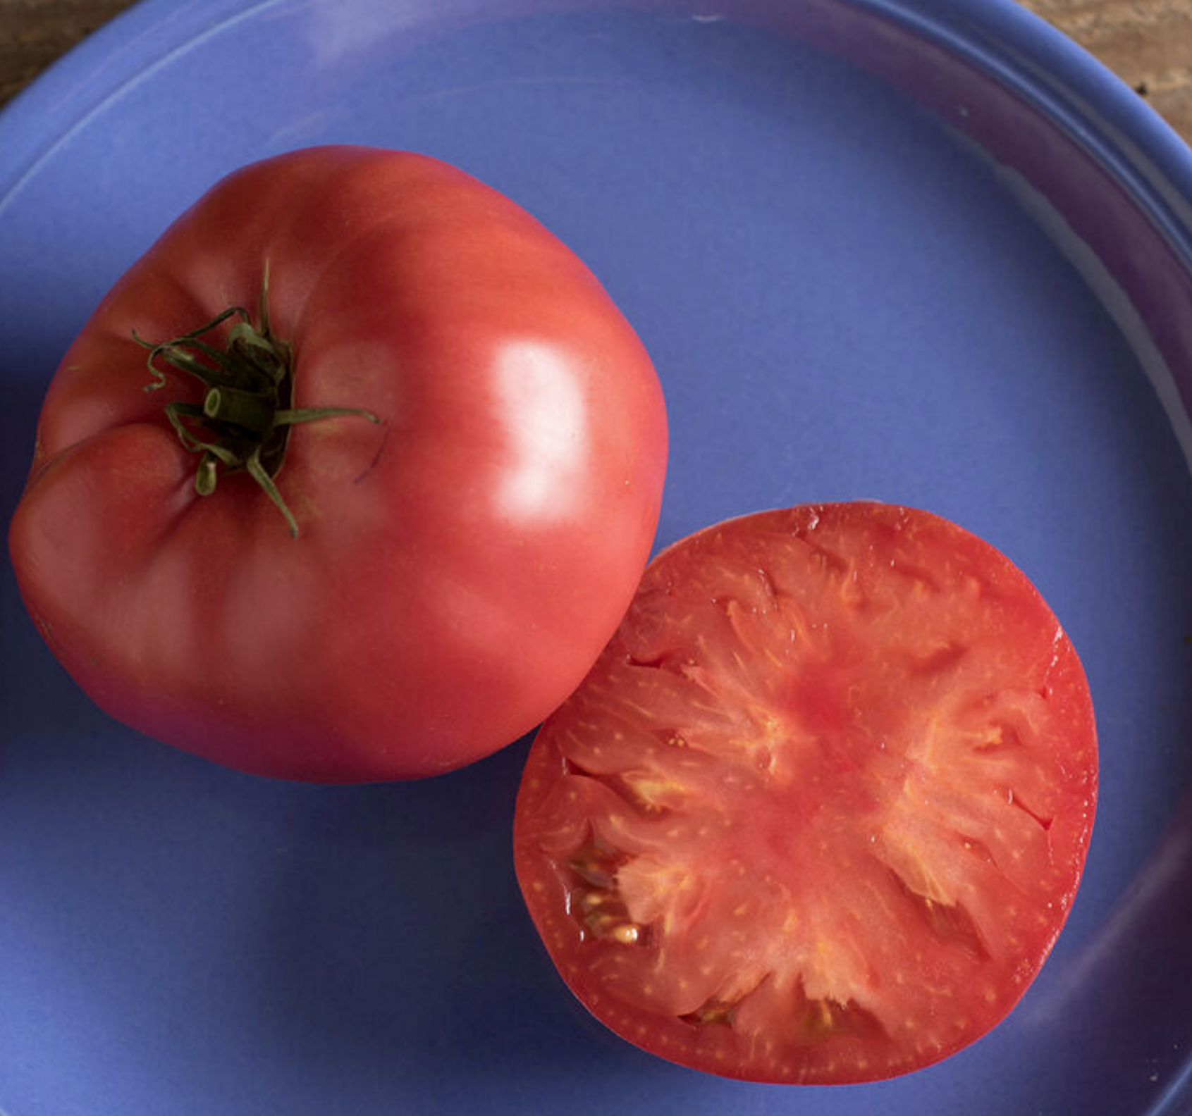
Use of Transplants
Benefits (Dufault 1998)
Uniformity
Quality
Growth rate
Several annual vegetables suitable for transplanting
Increasing importance (Diaz-Perez et al. 2008)
Demand for locally grown
Difficulties with expansion
Notes:
Growing an annual crop from seed in a single growing season may not be feasible in many locations, especially in areas with late spring and/or early fall freezes. Using transplants to enable commercial-scale production of annual vegetable crops in a single season is a common practice to increase plants' quality, uniformity, and growth rates. Although not all specialty crops are suitable for transplanting, several annual vegetables such as eggplant, kale, broccoli, onion, bell pepper, and tomato can be grown from transplant stock.
Transplant production is likely to become more important as demand for locally grown food increases since it could enable small and mid-size farms to produce and harvest more uniform produce. However, both supply and quality of transplants may be inadequate to support expansion of local production, and questions remain about fertility requirements for best quality seedlings and transplants.

Slide 3
Research Objectives
Address common problem (fertility) encountered by growers and study the effect of organic fertilizers on transplant growth
Informal interviews
Data for production area and crop yield in Iowa (USDA-NASS 2017; Enderton et al. 2017)
Why the tomato crop?
Common crop
Among those that have least environmental impact when grown locally (Stone et al. 2021)
Questions remain about organic methods for transplants (fertility, best seedling quality) (Li and Mattson 2019; Nair et al. 2011)
Notes:
My overall research objective is to address a common problem encountered by small-scale commercial farmers that could lead to increased quality and quantity of vegetable crops for local production. Based on data for production area and crop yields in Iowa and informal interviews with Master Gardeners in central Iowa and personnel associated with two small-scale growing operations in the Des Moines area, I chose to examine production of organic tomato transplants with different fertilizer applications. Tomatoes are a commonly grown crop and are also among those that may have least environmental impact when grown locally at a small to medium-sized commercial scale.

Slide 4
Methods
Organic fertilizers added to ‘Beautiful Land’ organic media
Fish emulsion (2-4-1)
Bone meal (3-15-0)
Blood meal (12-0-0)
Feather meal (12-0-0)
Preliminary trial – one replication of each treatment (high and low rate)
Full trial – four reps each treatment (high and low rate) + four control reps
Experimental units: four plants within each 25-cell tray
Notes:
To study the effect of organic fertilizers on tomato transplant crop growth, I examined additions of organic bone meal, blood meal, feather meal, and fish emulsion to a standard organic media (‘Beautiful Land’) mix for plants grown under uniform temperature, relative humidity and light conditions in a greenhouse. A preliminary trial was conducted, and we tested one replication of four rates of each dry fertilizer: 2-4-8-16 tbsp/gal of media. Plants were grown for 10 days to ascertain adequate germination as a trial before establishing the full experiment.
Based on the preliminary trial, I tested dry fertilizer applied at rates of two Tbsp/gal of media and 4 Tbsp/gal of media. Two rates of fish emulsion application were used, at one ounce per gallon of water applied and at 2 ounces per gallon of water. Each treatment included 100 plants arranged in 25-cell transplant trays, and all plant material was placed in a random arrangement on growing benches in a single greenhouse bay.
The experimental units for this study were groups of four plants in the center of each 25-cell transplant tray.

Slide 5
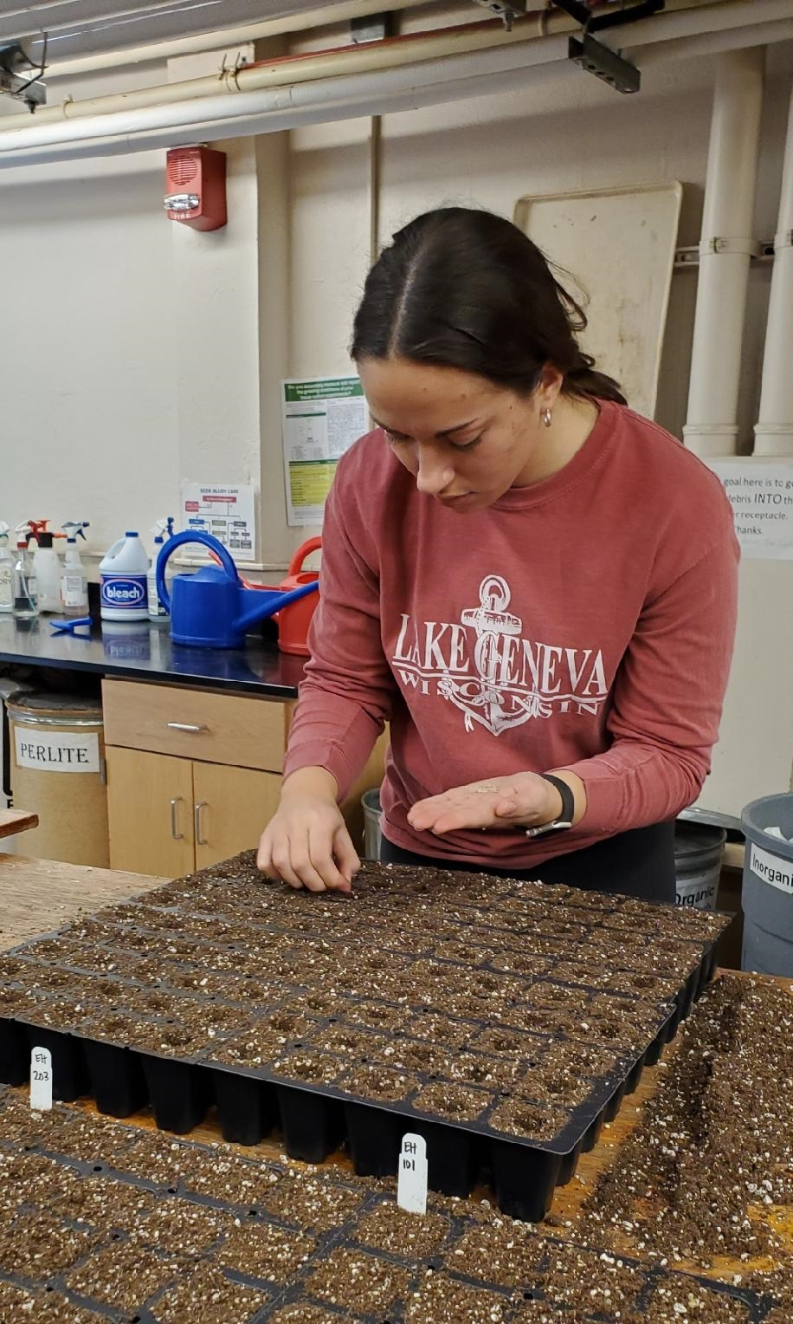
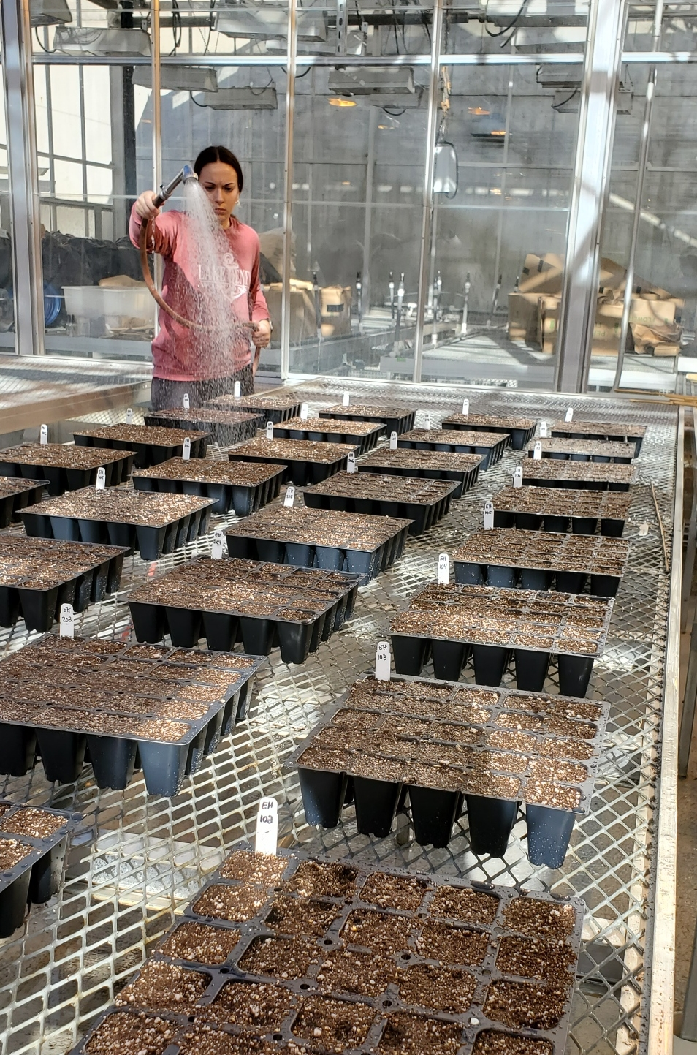
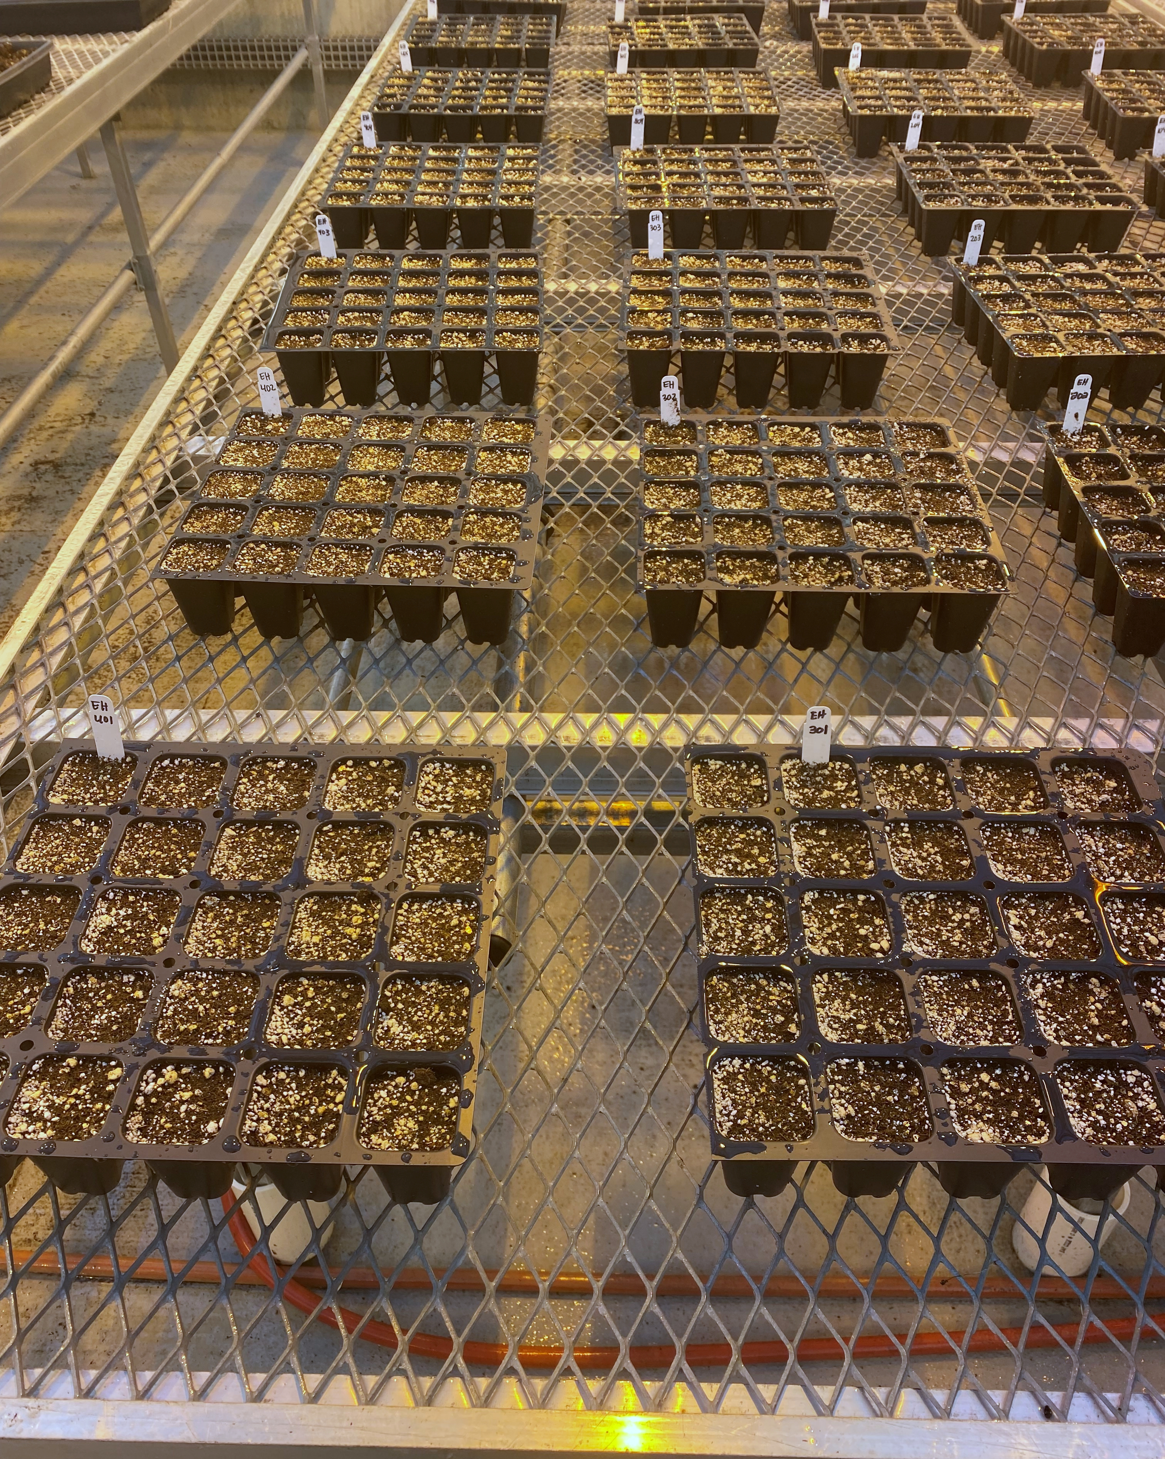
Seeding & Methods cont.
Notes:
I measured and recorded individual plant height, stem diameter, and Soil Plant Analysis Development (SPAD) meter readings at weeks four, five, and six after seeding. At the end of the transplant production period, I recently conducted destructive sampling with the four experimental unit plants per treatment. This included root washing, plant drying and data collection with WinRHIZO root scanning software.

Slide 6
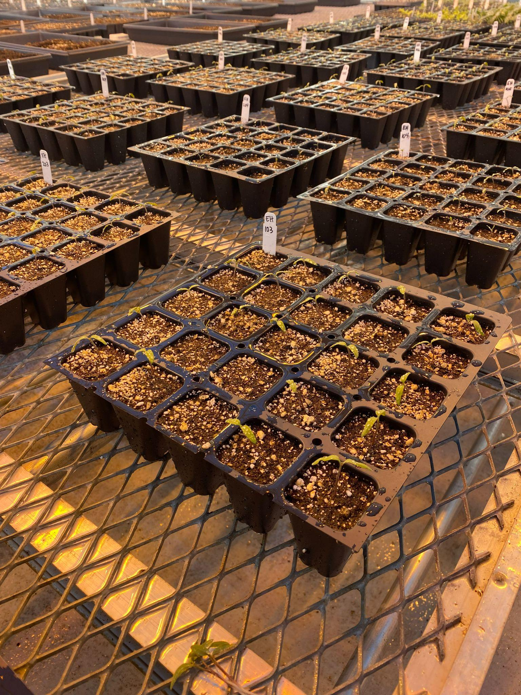
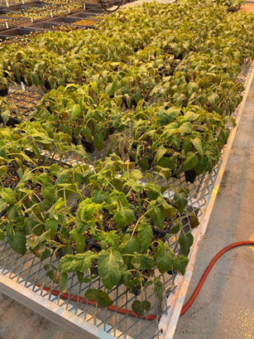
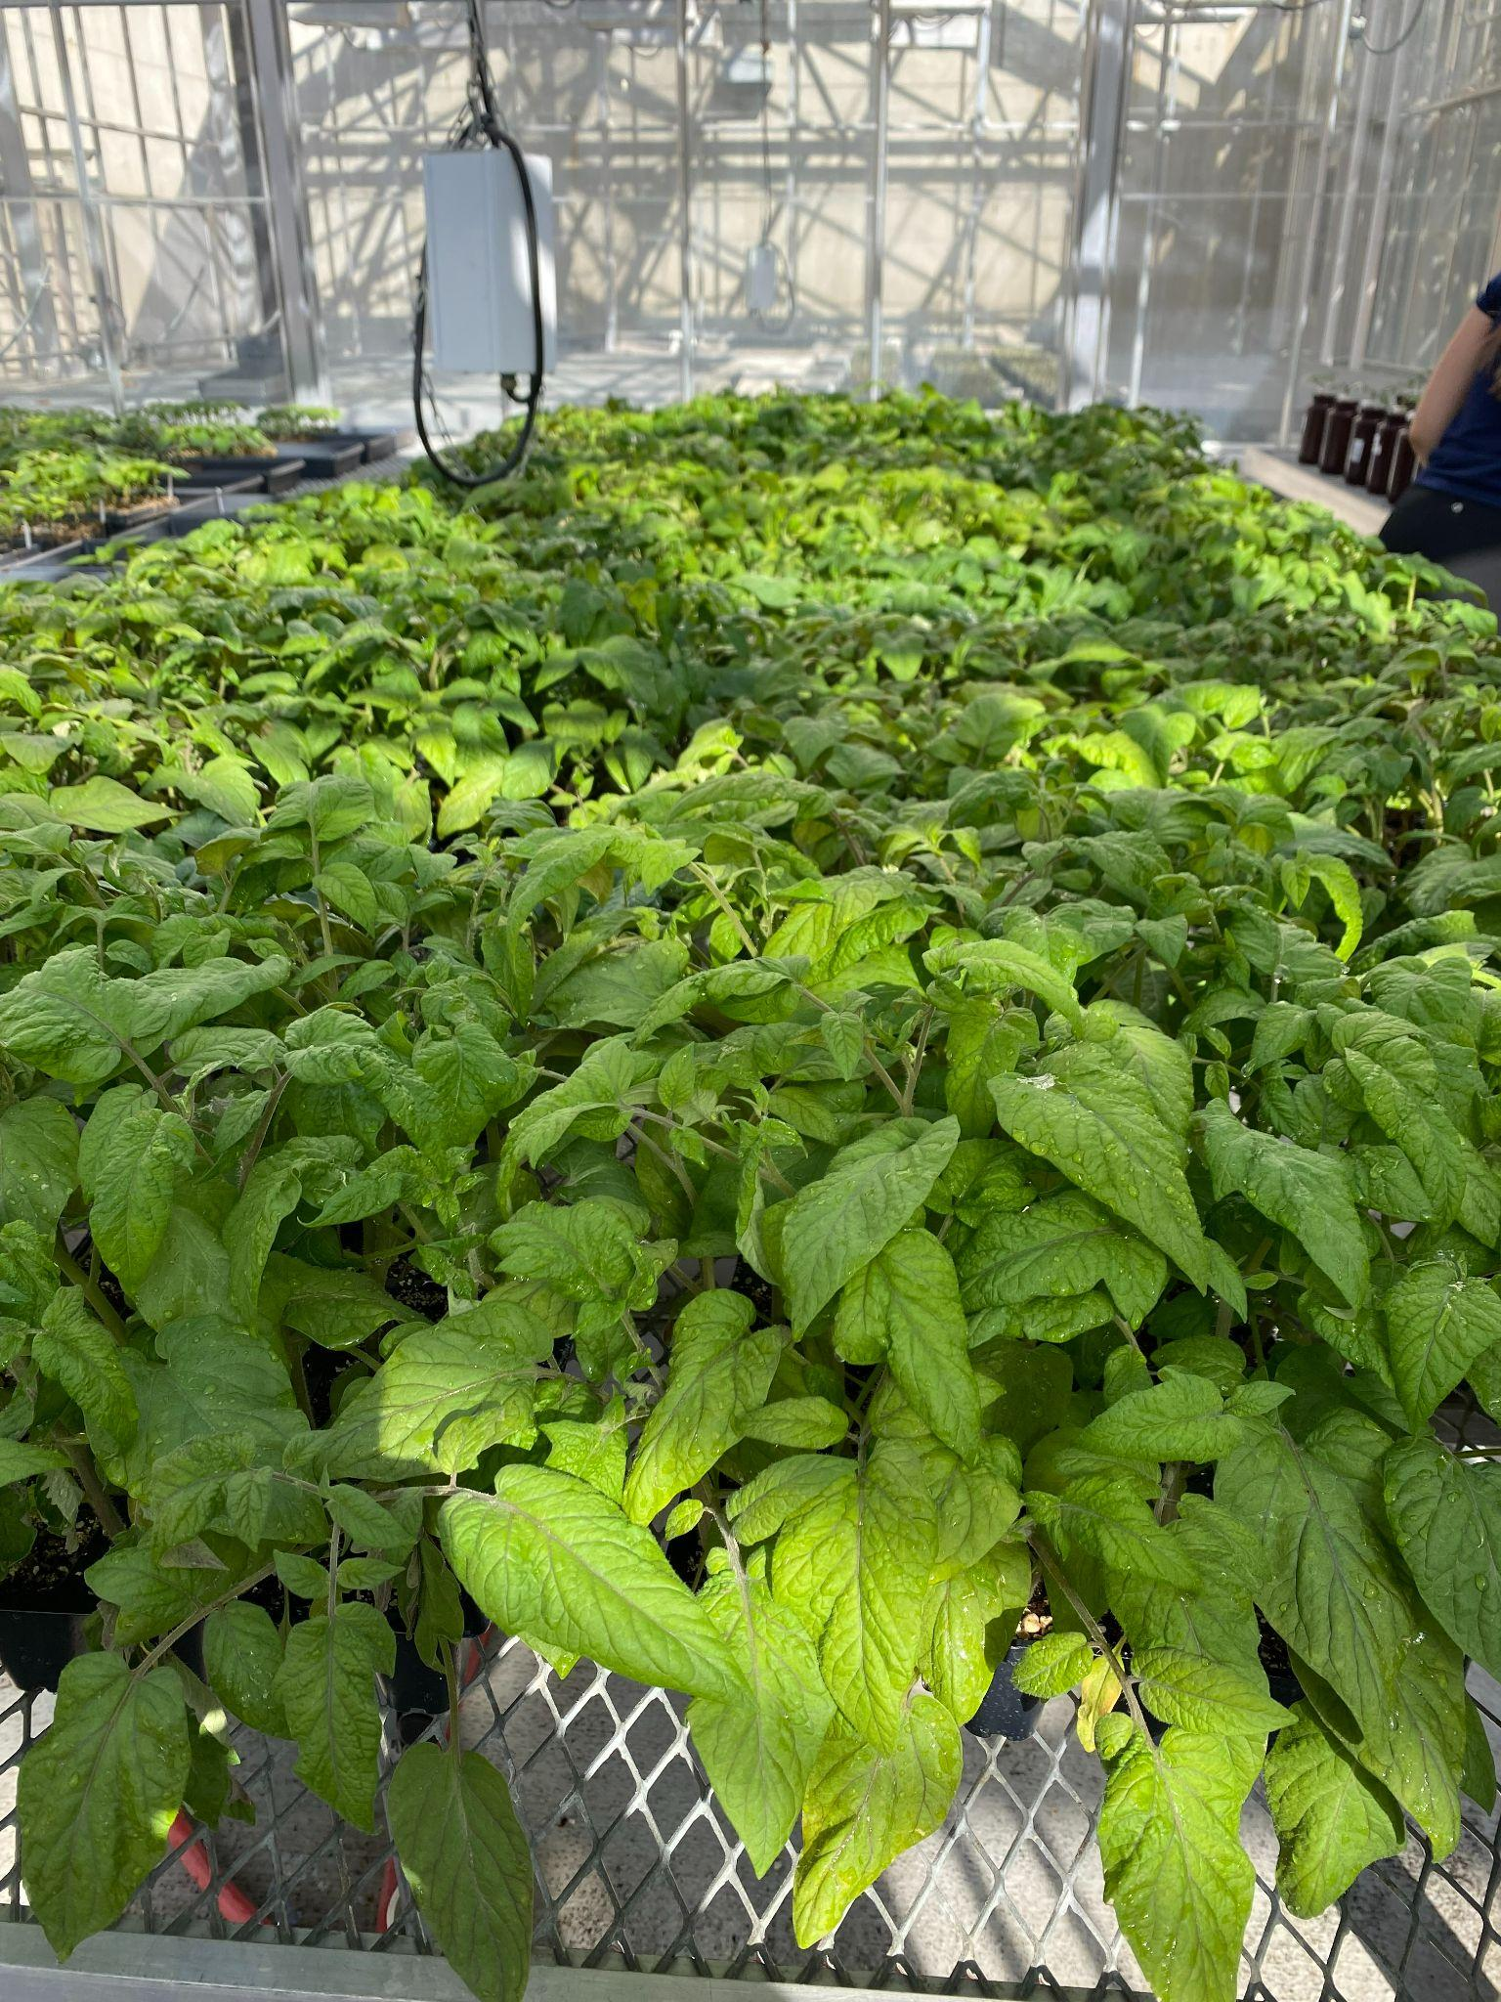
Seedling Growth
Notes:
Here is a start to finish look at the seedling growth from sprouting to right before deconstructive sampling.

Slide 7
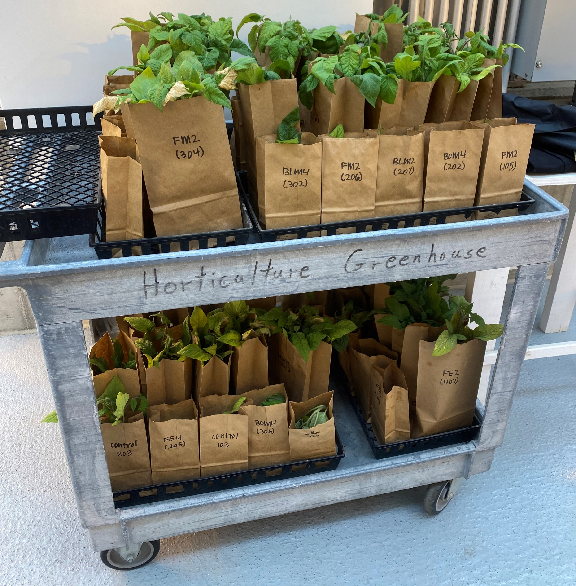
Expected Results
Fish emulsion to produce higher nutrient content in transplants
High rates of dry fertilizer may hinder plant growth
Treatments based on recommended application will perform well
Notes:
I expect that plants grown with fish emulsion will have a higher nutrient content than those grown with dry solid fertilizer, with highest nutrient content corresponding to the high rate of fish emulsion and lowest nutrient content for one of the low rates of dry solid fertilizer application. High rates of dry solid fertilizer may hinder plant growth. Plants that receive recommended rates of dry solid fertilizer and fish emulsion will perform well based on consideration of all plant measurements. Root to shoot ratios will likely be smaller for higher rates of fertilizers applied (dry solid and liquid fish emulsion), and larger for lower rates of fertilizer.

Slide 8
References
Dufault, R. J. (1998). Vegetable transplant nutrition. HortTechnology, 8(4), pp.515-523. https://doi.org/10.21273/HORTTECH.8.4.515
Diaz-Perez, J., Silvoy, J., Pphatak, S., Pitchay, D., Morse, R. (2008). Organic tomato transplant production in compost-amended substrate. Acta Hort. https://doi.org/10.17660/ActaHortic.2008.782.29
Enderton, A., Bregendahl, C., Swenson, D., Adcock, L. (2017). Iowa Commercial Horticulture Food Crop Survey Results. Available from ISU Extension and Outreach. https://www.extension.iastate.edu/ffed/
USDA NASS (National Agricultural Statistics Service). (2017). Census of Agriculture - Iowa State Data Table 36 (pp. 454-469). USDA-NASS: Washington DC
Stone, T., Thompson, J., Rosentrater, K., & Nair, A. (2021). A life cycle assessment approach for vegetables in large-, mid-, and small-scale food systems in the Midwest US. Sustainability (Basel, Switzerland), 13(20), 11368. https://doi.org/10.3390/su132011368
Li, Y., Mattson, N. (2019). Effect of organic fertilizer source and rate on growth and nutrient leachate profile of greenhouse-grown cucumber. HortTechnology, 29(4), 450-456. https://doi.org/10.21273/HORTTECH04293-19
Nair, A., Ngouajio, M., Biernbaum, J. (2011). Alfalfa-based organic amendment in peat-compost growing medium for organic tomato transplant production. HortScience, 46(2), 253-259. https://doi.org/10.21273/HORTSCI.46.2.253

