Slide 1
Promoting rooftop photovoltaic panels for low carbon and resilient neighborhoods using a consumer-friendly interactive GIS-based map
College of Design
Sedigheh Ghiasi
College of Design
Advisor: Prof. Ulrike Passe
Committee: Dr. Yuyu Zhou – Prof. Rob Whitehead

Slide 2
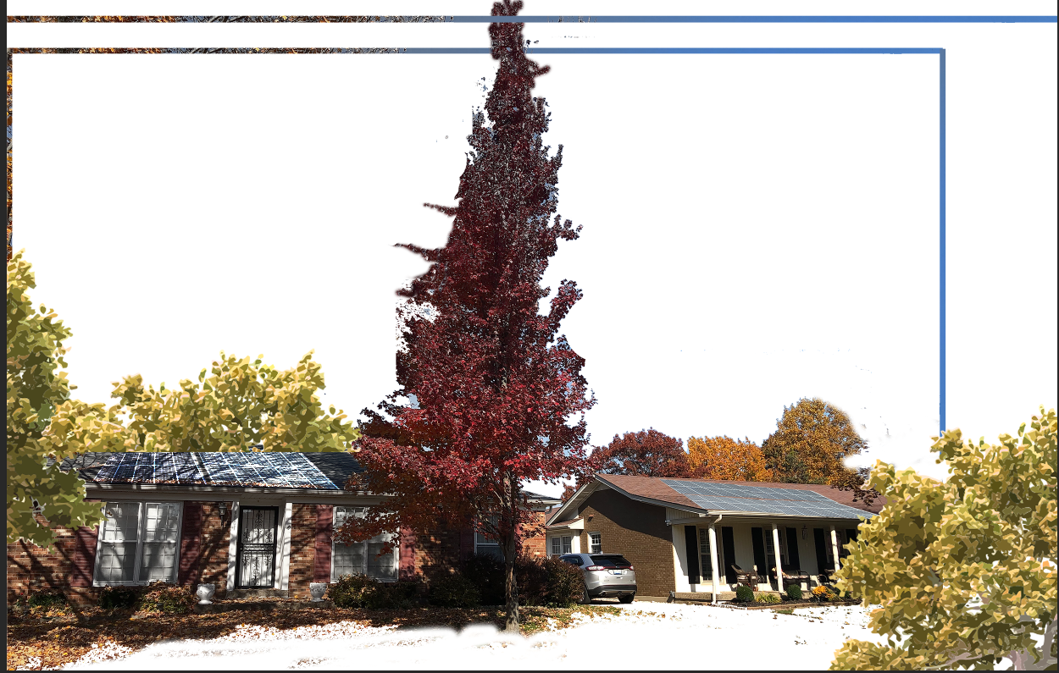
A residential solar panel system has the capability of providing for the electricity needs of an entire home with about 80% lower carbon emissions than fossil fuels.
How can we encourage non-expert users
to install PV panels?
Customer's Hesitation with Solar Panel Installations
Low carbon footprint vs carbon debt
Solar panels can pay off their carbon debt
3 years after installation
Developing an interactive GIS-based map
for non-expert users
Background
Notes:
https://nature.berkeley.edu/classes/es196/projects/2013final/ArifM_2013.pdf

Slide 3
Motivation
What is our innovation?
Primary :
A need for a technology that can offer guidance to non-expert users to easily find the best placement of PV panels while considering shading effects.
The proposed approach is user-friendly and interactive.
It can accurately calculate the shading effect of surrounding obstacles.
The method was tested in Capitol East, Des Moines, Iowa, USA. As the algorithm was built using Python, it can be transferred to other cities.
secondary :
The desire of homeowners to have the ability to estimate energy saving due to the installation of PV panels
Motivation

Slide 4
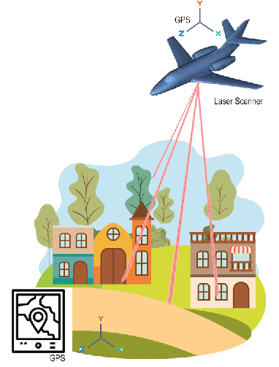
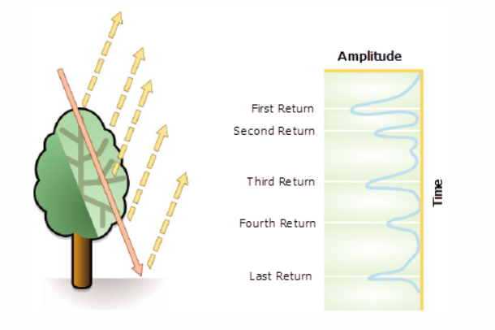
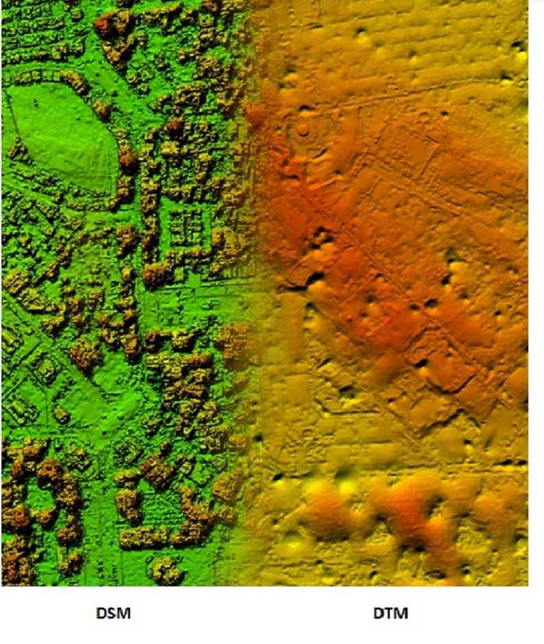
Light Detection and Ranging (Lidar)
Credit: : http://revistamapping.com/2019/01/23/1620/
Digital Surface Model (DSM):presents elevation of above-ground features such as buildings, vegetation, and trees
Introduction- Key words

Slide 5
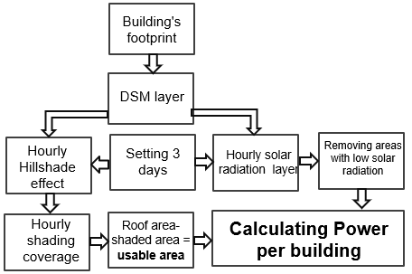
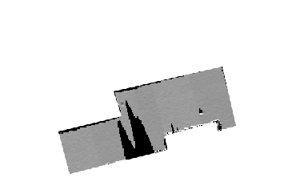
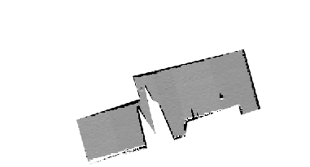
Workflow of research
whole roof area
Shaded area
Usable area on each hour
Methodology
Notes:
Workflow of research, using GIS data to determine the feasible area for rooftop PV panels installation. Source: Author Could you try not to overlap the last bottom right boundary with the arrow

Slide 6
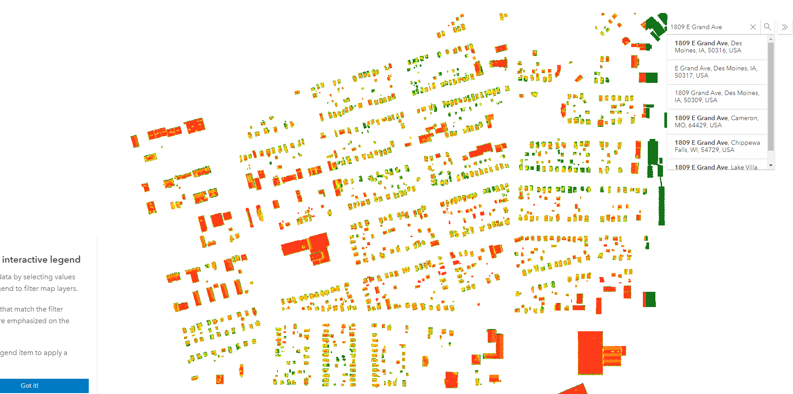

Slide 7
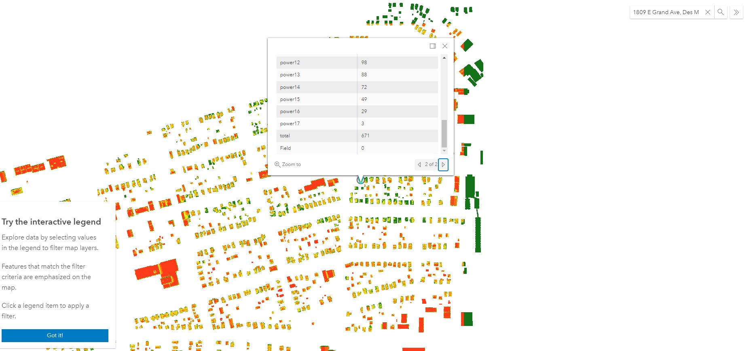
showing the best placement of PV panels and daily electricity production of each building
address entered by users

Slide 8
Thank you….

